Slide 1

Advanced Composition

Slide 2
Agenda
Type checking using PropTypes
Component Lifecycle
Error Boundaries
Refs and Input
React Forms – Controlled vs. Uncontrolled Components
Rendering Multiple Components with Keys
Styling and Animation
Component Approaches (HOC, Container)

Slide 3
PropTypes
Run time type validation for React components
Was initially included as part of React, but recently moved to a separate package
yarn add prop-types
Makes sharing components between large teams easier
Defined PropTypes are optional by default
Notes:
There’s more to a React Component, but will get to that in a bit

Slide 4
PropTypes Example
import PropTypes from 'prop-types';
class Greeting extends React.Component {
render() {
return ( <h1>Hello, {this.props.name}</h1> );
}
}
Greeting.propTypes = {
name: PropTypes.string
};
* example from react website
** notice that the class property is in lower case (propTypes)
Notes:
There’s more to a React Component, but will get to that in a bit

Slide 5
PropTypes Native Types
PropTypes.array
PropTypes.bool
PropTypes.func
PropTypes.number
PropTypes.object
PropTypes.string
PropTypes.symbol
PropTypes.any
Notes:
There’s more to a React Component, but will get to that in a bit

Slide 6
Making PropTypes Required
Just add .isRequired at the end of a propType definition to make it required
import PropTypes from 'prop-types';
class Greeting extends React.Component {
render() {
return ( <h1>Hello, {this.props.name}</h1> );
}
}
Greeting.propTypes = {
name: PropTypes.string.isRequired
};
* example from react website
Notes:
There’s more to a React Component, but will get to that in a bit

Slide 7
Complex PropTypes
node - Anything that can be rendered (string, numbers, elements and arrays of these types)
element - React Element
instanceOf(<class>) - Instance of a class
oneof([‘one’, ‘two’]) - an array of optional values
Notes:
There’s more to a React Component, but will get to that in a bit

Slide 8
Complex PropTypes
oneOfType([propType]) - an array of optional types
arrayOf(<type>) - an array of a propType
objectOf(<type>) - an object with properties of specific types
shape – an object of specific "shape"
Notes:
There’s more to a React Component, but will get to that in a bit

Slide 9
PropTypes - Shape
import PropTypes from 'prop-types';
class Greeting extends React.Component {
render() {
return ( <h1>Hello, {this.props.name}</h1> );
}
}
Greeting.propTypes = {
name: PropTypes.shape ({
firstName: PropTypes.string,
lastName: PropTypes.string
})
};
We will generally create a shared library of shapes that will be reused across the app
Notes:
There’s more to a React Component, but will get to that in a bit

Slide 10
Default Props
May want to define default values for non-required props
Can do so via defaultProps
Simple key/value object – propName/value
import PropTypes from 'prop-types';
class Greeting extends React.Component {
render() {
return ( <h1>Hello, {this.props.name}</h1> );
}
}
Greeting.propTypes = {
name: PropTypes.string
};
Greeting.defaultProps = {
name: 'John Doe'
};

Slide 11
Notes:
Add

Slide 12
Component Lifecycle

Slide 13
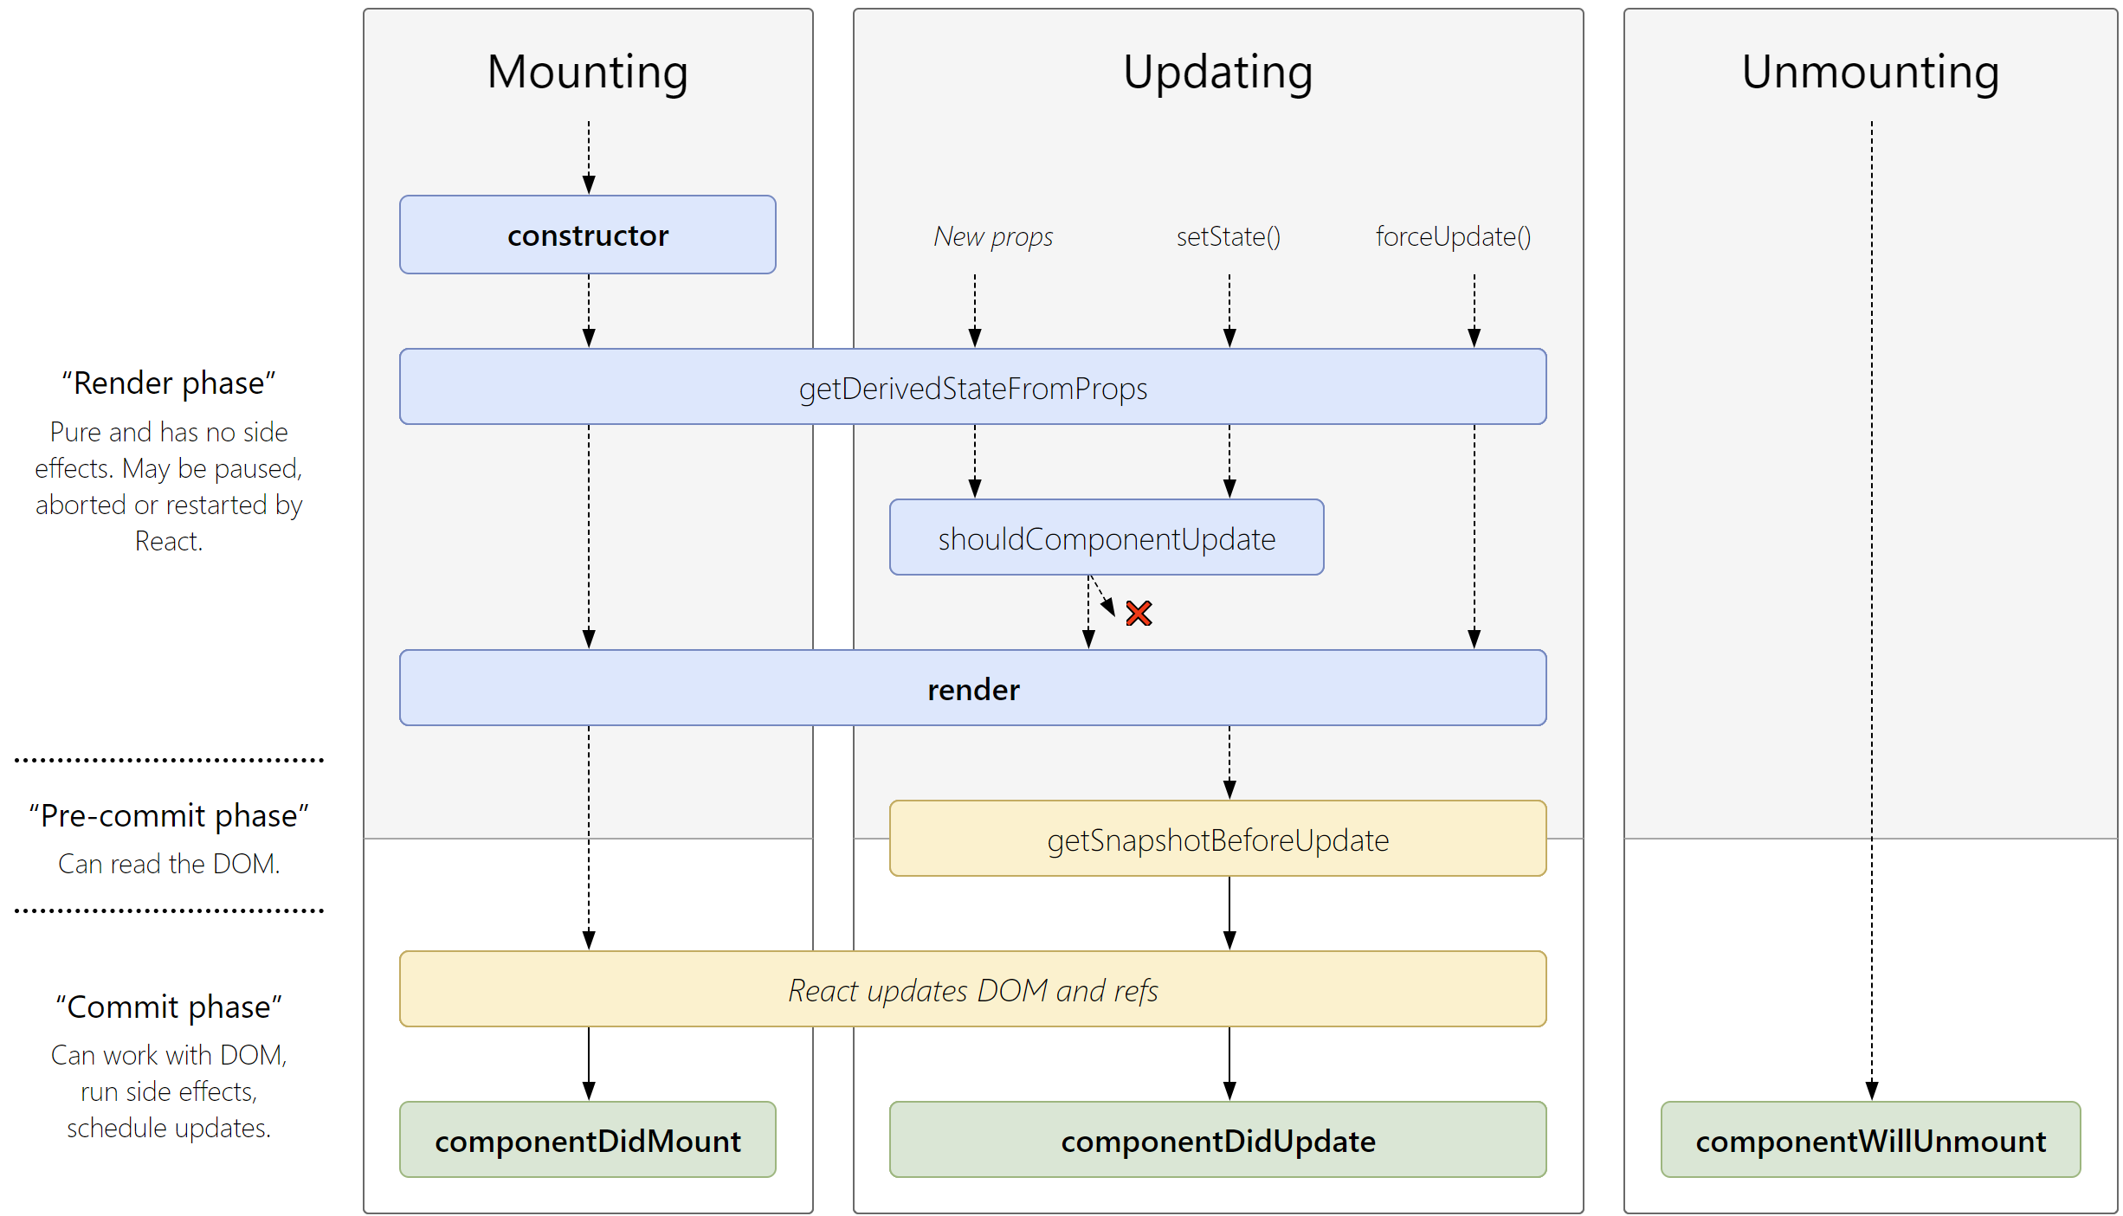
Component Lifecycle
Source

Slide 14
constructor(props)
Part of every ES6 Class (so not React specific)
Should call super(props) first
Used to initialize state
Remember, do not use setState here
Called when the class is instantiated
Before ES6 Class we used getInitialState
Notes:
There’s more to a React Component, but will get to that in a bit

Slide 15
UNSAFE_componentWillMount()
Called once before mounting
Can be used to initialize state
setState should not be used (will cause a re-render)
Can use the constructor instead
Legacy – constructor or componentDidMount instead
Notes:
There’s more to a React Component, but will get to that in a bit
[GN] – I removed “alternatively” from the 3rd bullet (can use the constructor)
[GN] – I rephrased the setState bullet

Slide 16
componentDidMount()
Fired once the component mounts
You now have access to the DOM
Good place for
Adding event listeners (that require DOM access)
Making initialization related ajax calls
Instantiating DOM related libraries (Canvas drawing etc.)
Notes:
There’s more to a React Component, but will get to that in a bit

Slide 17
Notes:
Add

Slide 18
UNSAFE_componentWillReceiveProps(nextProps)
Called before new props are received on a mounted component
Accepts an object containing the new props
Does not get called with the initial props during mounting
Can happen even if props don't really change
Should compare new props to old props and verify
Used to update state based on props
Legacy – getDerivedStateFromProps instead
Notes:
There’s more to a React Component, but will get to that in a bit

Slide 19
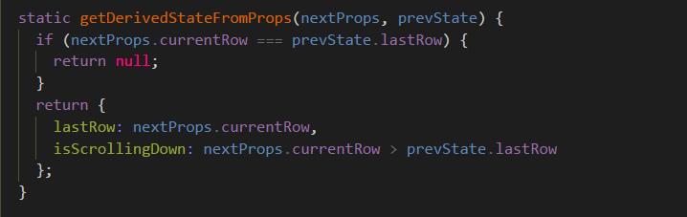
static getDerivedStateFromProps(props, state)
Invoked right before render takes place
Includes initial and consequent rendering
Replaces legacy 'componentWillReceiveProps'
No call to setState (static)
Returns an object of updated state or null if no update is necessary
Notes:
The returned value behaves similarly to current setState value — you only need to return the part of state that changes, all other values will be preserved.
getDerivedStateFromProps is called both on initial mounting and on re-rendering of the component, so you can use it instead of creating state based on props in constructor.
Usually, you would use a callback to make sure some code is called when the state was actually updated — in this case, please use componentDidUpdate instead.

Slide 20
UNSAFE_componentWillUpdate(nextProps, nextState)
Is called just before rendering when new props or state are received
Not called on initial render
Used for last minute actions before re-render
Can sometimes replace componentWillReceiveProps but is not very useful
Legacy – componentDidUpdate instead
Notes:
There’s more to a React Component, but will get to that in a bit

Slide 21
getSnapshotBeforeUpdate(prevProps, prevState)
Called before DOM is updated
Return an object that will be passed as a third parameter to componentDidUpdate
Useful for cases like maintaining scroll position during re-renders
Together with componentDidUpdate, replaces the need for componentWillUpdate

Slide 22
componentDidUpdate(prevProps, prevState, snapshot)
Fired immediately after the component is updated
Not called for initial render
Used to update the DOM upon changes (re-arrange grid, re-draw canvas etc.)
Notes:
There’s more to a React Component, but will get to that in a bit

Slide 23
shouldComponentUpdate(nextProps, nextState)
Component received new props / state and is going to re-render
Returns a Boolean (true for should render, false for should not render)
By default React always re-redners the tree (view)
Used to improve performance by avoiding unnecessary renders
But wait!
Notes:
There’s more to a React Component, but will get to that in a bit

Slide 24
componentWillUnmount()
Called before we destroy / unmount the component
Used for cleanup – mostly removing event listeners
Notes:
There’s more to a React Component, but will get to that in a bit

Slide 25
Breaking it Down
Set initial synchronous state
Constructor or field initializer
Load initial state asynchronously
componentDidMount
Listeners / subscriptions
Create – componentDidMount / Cleanup – componentWillUnmount
Updating state according to props
getDerivedStateFromProps
Invoke external callbacks when self state changes
componentDidUpdate
Side effects on props change (e.g. async calls)
componentDidUpdate
Notes:
https://reactjs.org/blog/2018/03/27/update-on-async-rendering.html

Slide 26
Props and Async Calls
class ExampleComponent extends React.Component {
state = { data: null };
static getDerivedStateFromProps(props, state) {
// Make sure to compare that prop really changed
// Reset previous data (so we don't render stale stuff)
return (props.id !== state.prevId) ? { data: null, prevId: props.id} : null;
}
componentDidMount() {
this._loadAsyncData(this.props.id);
}
componentDidUpdate(prevProps, prevState) {
if (this.state.data === null) {
this._loadAsyncData(this.props.id);
}
}
…
}
class ExampleComponent extends React.Component {
…
render() {
if (this.state.data === null) {
// Render loading state ...
}
else {
// Render real UI ...
}
}
_loadAsyncData(id) {
asyncLoadData(id).then(data => this.setState({data}));
}
}

Slide 27
Error Boundaries

Slide 28
Error Boundaries
As of React 16
Uncaught errors by any error boundary results in unmounting the whole component tree
Should a rendering error break your app?
Debatable
How about UI error handling?
Display a fallback UI
Log errors
In React, you don't control the instantiation and rendering of children
Standard try/catch cannot suffice

Slide 29
Error Boundaries
React's error boundaries are simple class components
Component needs to implement either of these lifecycle method
componentDidCatch(error, info)
static getDerivedStateFromError(error)
Catches errors in their underlying component tree
Constructors
Life-cycle methods
Rendering

Slide 30
componentDidCatch(error, info)
Error
The thrown error
Info
Has a 'componentStack' key
Holds information about relevant component stack
Choose what to do
Usually logging

Slide 31
static getDerivedStateFromError(error)
Invoked after an error is thrown by a descendant component
Receives the error object
Returns an object to update state with
Usually to render fallback UI
Called during render, side-effects are not allowed
Use componentDidCatch instead

Slide 32
class ErrorBoundary extends React.Component {
constructor(props) {
super(props);
this.state = {
error: null,
};
}
static getDerivedStateFromError(error) {
return { error };
}
componentDidCatch(error, errorInfo) {
logErrorUtil(error, errorInfo);
}
…
}
class ErrorBoundary extends React.Component {
…
render() {
if (this.state.error) {
return (
<div>
<h2>Something went wrong.</h2>
{this.state.error
&& this.state.error.toString()}
</div>
);
}
return this.props.children;
}
}
export default App = () => (
<ErrorBoundary>
<BuggyChild />
</ErrorBoundary>);

Slide 33
Error Boundaries DO NOT CATCH
Event handlers
Use standard try/catch
Asynchronous code
E.g. setTimeout / setInterval
Server-side rendering
Errors thrown in the boundary itself or above it
Notes:
Event handlers – if it triggers a rendering process (e.g. setState) then it is caught, meaning the internal logic (e.g. – calling a REST api)

Slide 34
Advanced Composition

Slide 35
Class Component - forceUpdate
React's rendering process kicks in when props or state changes
If a component depends on something else
Can instruct React to re-render the component
Call method 'forceUpdate'
Skips the specific component's shouldComponentUpdate if implemented
Should generally be avoided

Slide 36
React.PureComponent
Implements shallow prop and state comparison
shouldComponentUpdate
Avoids unnecessary renders
Simply extend React.PureComponent (instead of Component)
Notes:
Can be problematic – affects children re-rendering in case they relied on it
Can have performance degradation if not used properly (e.g. giving a prop callback that always creates a new function)

Slide 37
React.memo
Pure components, only for functional components
No class, can't derive from PureComponent
Bails out of rendering when props are the same
Shallow comparison
Can pass a second parameter to provide a custom comparison function
const MyComponent = React.memo(function MyComponent(props) {
/* only rerenders if props change */
});

Slide 38
React ref
React allows you to get a direct reference to an element via `ref`
Components or native elements
Cannot assign ref to functional components
Functional components don't have class instances
Suggested use cases:
Managing focus, text selection, media playback etc.
Triggering imperative animations
Integration with third party DOM libraries
Notes:
There’s more to a React Component, but will get to that in a bit

Slide 39
React ref
Callback method
<input ref={(input) => { this.textInput = input; }} />
Simplified ref API
DOM element/ class component instance - accessible via 'current' property
textInputRef = React.createRef();
<input ref={this.textInput} />
Notes:
There’s more to a React Component, but will get to that in a bit

Slide 40
React ref
class CustomTextInput extends React.Component {
constructor(props) {
super(props);
this.focus = this.focus.bind(this);
}
focus() { // Explicitly focus the text input using the raw DOM API
this.textInput.focus();
}
render() {
return (
<div>
<input type="text" ref={(input) => { this.textInput = input; }} />
<input type="button" value="Focus" onClick={this.focus} />
</div>
);
}
}
Notes:
There’s more to a React Component, but will get to that in a bit

Slide 41
React ref
class CustomTextInput extends React.Component {
constructor(props) {
super(props);
this.focus = this.focus.bind(this);
this.textInputRef = React.createRef();
}
focus() { // Explicitly focus the text input using the raw DOM API
this.textInputRef.current.focus();
}
render() {
return (
<div>
<input type="text" ref={this.textInputRef} />
<input type="button" value="Focus" onClick={this.focus} />
</div>
);
}
}
Notes:
There’s more to a React Component, but will get to that in a bit

Slide 42
React ref
In previous versions of react you were able to pass a string to refs
ref=“myInput”
You could then access the value through this.refs.myInput
It still works (and can be found in many older React projects)
But it will be deprecated and should not be used
Notes:
There’s more to a React Component, but will get to that in a bit

Slide 43
Notes:
Auto focused input element

Slide 44
React Forms
There are two ways to work with forms in React
Controlled Components
Component state manages the form elements
Source of truth – component
Uncontrolled Components
Ref is used to access the form elements
Source of truth – DOM
Each element manages its own state
Notes:
There’s more to a React Component, but will get to that in a bit

Slide 45
Uncontrolled Components
By assigning refs to input fields we can access / modify their value
class NameForm extends React.Component
constructor(props) {
super(props);
this.handleSubmit = this.handleSubmit.bind(this);
}
handleSubmit(event) {
alert('A name was submitted: ' + this.input.value);
}
render() {
return (
<form onSubmit={this.handleSubmit}>
<label> Name: <input type="text" ref={(input) => this.input = input} /> </label>
<input type="submit" value="Submit" />
</form>
);
}}
* Example from React official docs
Notes:
There’s more to a React Component, but will get to that in a bit

Slide 46
Uncontrolled Components
Easier to write
To set initial values
Use defaultValue and defaultChecked
Avoid uncontrolled components
Responsibility and testability matter
* Example from React official docs
Notes:
There’s more to a React Component, but will get to that in a bit

Slide 47
Controlled Components
In HTML, form elements generally maintain their own state
When using Controlled Components react takes over
Add onChange callback and update component state
When component state updates, React re-renders elements with new values
Notes:
There’s more to a React Component, but will get to that in a bit

Slide 48
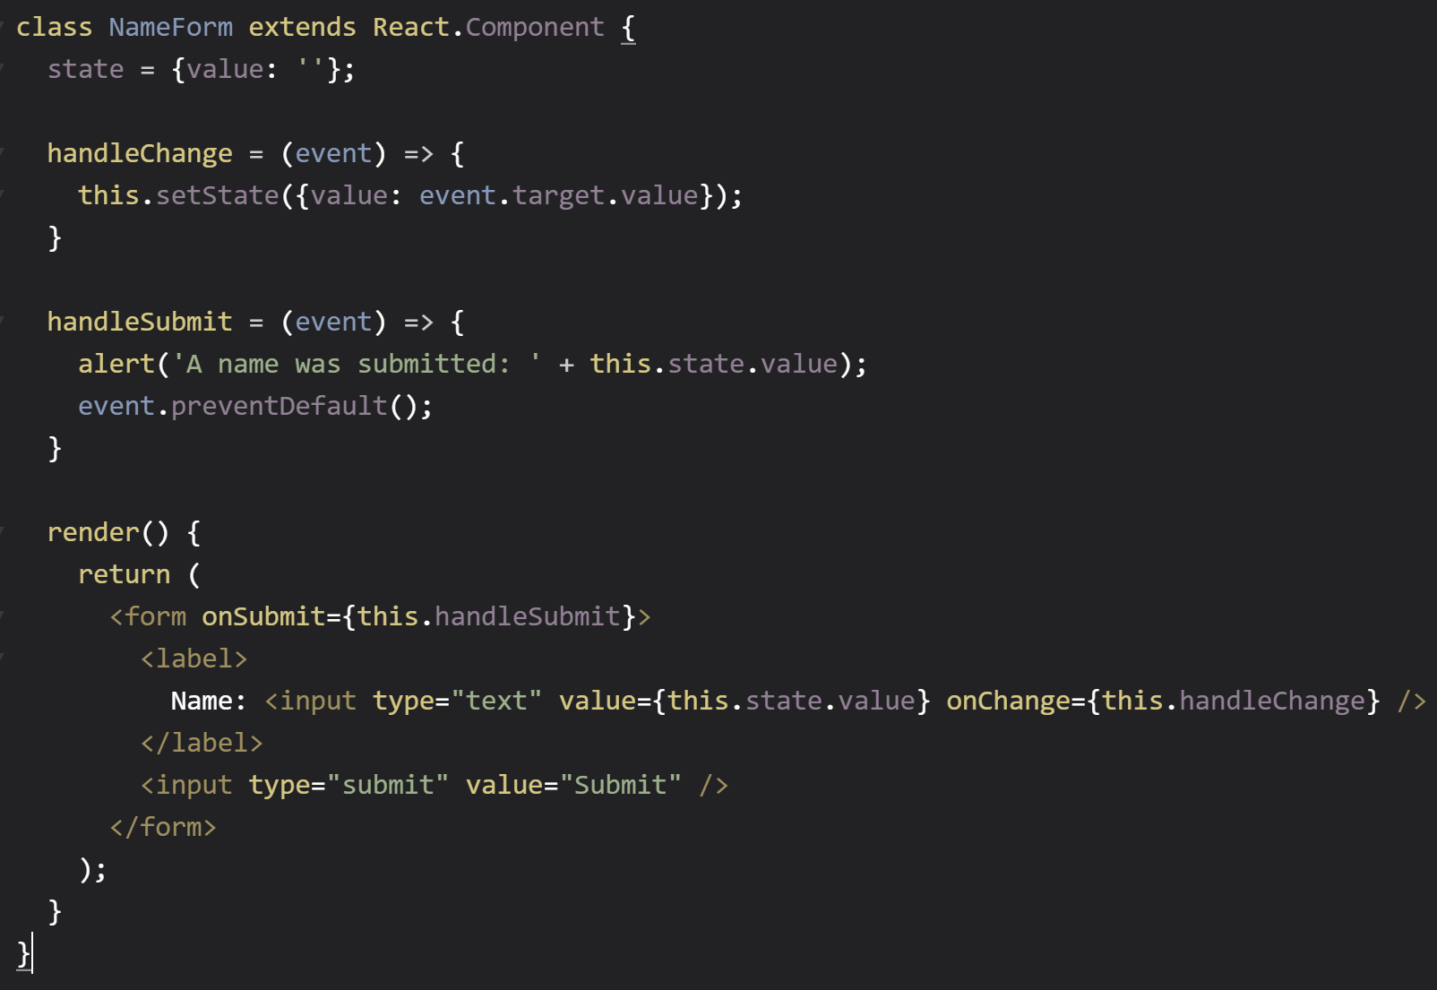
Controlled Components

Slide 50
4th Lesson

Slide 51
Quick Admin
* Example from React official docs
Notes:
There’s more to a React Component, but will get to that in a bit

Slide 52
React Forms – Recap
We can use the ref property to get direct access to the DOM
ref={(input) => { this.textInput = input; }}
Using ref we can fetch information from form elements
Which we demonstrated in our reddit app
But this is not the recommended way of using forms in React
Notes:
There’s more to a React Component, but will get to that in a bit

Slide 53
Input Example
const SingleInput = (props) => (
<input
type={props.inputType}
value={props.content}
onChange={props.controlFunc}
placeholder={props.placeholder} />
);
SingleInput.propTypes = {
inputType: React.PropTypes.oneOf(['text', 'number']).isRequired,
controlFunc: React.PropTypes.func.isRequired,
content: React.PropTypes.oneOfType([
React.PropTypes.string,
React.PropTypes.number,
]).isRequired,
placeholder: React.PropTypes.string,
};
Notes:
There’s more to a React Component, but will get to that in a bit

Slide 54
Input Example
Finally we need to make sure we define the function on the parent controller: and pass it to our controller
handleFullNameChange(e) {
this.setState({ ownerName: e.target.value });
}
Notes:
There’s more to a React Component, but will get to that in a bit

Slide 55
Select (Dropdown)
In HTML, you set `selected` attribute on the relevant option
In React, you set `value` attribute on the select tag
If placeholder is needed, can have a first empty option
Notes:
There’s more to a React Component, but will get to that in a bit

Slide 56
Select (Dropdown)
const ReactSelect = (props) => (
<select
value={props.content}
onChange={props.controlFunc}>
<option value="">{props.placeholder}</option>
{props.options.map((opt) => {
return (
<option key={opt} value={opt}>{opt}</option>
);
})}
</select>
);
ReactSelect.propTypes = {
options: React.PropTypes.array.isRequired,
selectedOption: React.PropTypes.string,
controlFunc: React.PropTypes.func.isRequired,
placeholder: React.PropTypes.string
};
Notes:
There’s more to a React Component, but will get to that in a bit

Slide 57
Options / Radio Buttons
setName represents the `name` of the radio buttons
Groups them together
selectedOptions is an array of the selected options
* listType is used to select between Radio button and Checkbox
Notes:
There’s more to a React Component, but will get to that in a bit

Slide 58
Option / Radio Buttons
const CheckboxGroup = (props) => (
<div>
{props.options.map(opt => {
return (
<label key={opt} className="form-label capitalize">
<input
name={props.setName}
onChange={props.controlFunc}
value={opt}
checked={props.selectedOptions.indexOf(opt) > -1}
type={props.listType} /> {opt}
</label>
);
})}
</div>
);
CheckboxOrRadioGroup.propTypes = {
listType: React.PropTypes.oneOf(['checkbox', 'radio']).isRequired,
setName: React.PropTypes.string.isRequired,
options: React.PropTypes.array.isRequired,
selectedOptions: React.PropTypes.array,
controlFunc: React.PropTypes.func.isRequired
};
Notes:
There’s more to a React Component, but will get to that in a bit

Slide 59
Form Validation Basics
Validation is done on the form level (not the component) as that is where the state is managed
We create an Error object with a key for each component
{ name: this.state.name.length > 3, age: validateAge() }
If any of the keys in the object are set to true, the for is invalid
This is just one implementation, there are others
Notes:
There’s more to a React Component, but will get to that in a bit

Slide 60
Form Validation
React doesn't provide built-in support for form validation
Several alternatives
HTML native form validation
Custom implementation
Use another existing package
Notes:
There’s more to a React Component, but will get to that in a bit

Slide 61
React Forms
Creating a complete set of components is time consuming
You still need to add many properties and validation
In reality, most developers use existing forms libraries
Popular solutions
Redux Form (http://redux-form.com/)
MobX React Form (https://foxhound87.github.io/mobx-react-form/)
Notes:
There’s more to a React Component, but will get to that in a bit

Slide 62
Notes:
Auto focused input element

Slide 63
Using Keys for Siblings
React expects to receive a unique key property for each item in a list
The key should be unique and ‘stable’
If your elements do not contain a unique ID you can use the element position – but this will impact performance
React only compares same level elements by default – when the order changes, both tree branches
By using unique Keys react can detect a position change and simply move the branches, instead of redrawing them
Notes:
There’s more to a React Component, but will get to that in a bit

Slide 64
React Keys
Original
Update state
<ul>
<li>element 1</li>
<li>element 2</li>
</ul>
<ul>
<li>element 2</li>
<li>element 1</li>
</ul>
Notes:
There’s more to a React Component, but will get to that in a bit

Slide 65
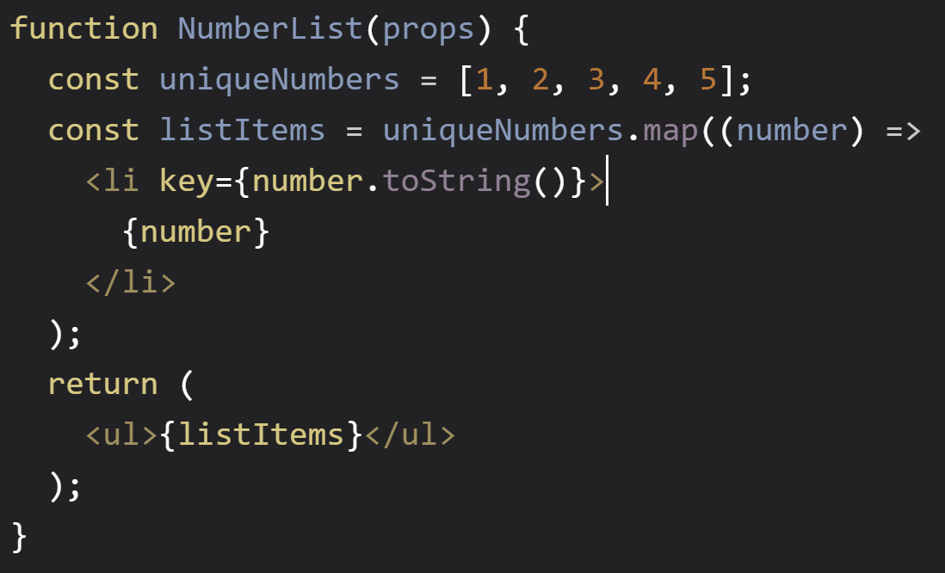
React Lists and Keys
React recognizes a specialized prop called key
Helps React identify list-based changes (changed, added, removed, moved)
Improves performance by optimizing DOM changes
key should be unique and ‘stable’
Id / index is okay if order is preserved
Notes:
React only compares same level elements by default – when the order changes, both tree branches
By using unique Keys react can detect a position change and simply move the branches, instead of redrawing them

Slide 66
Styling React Components
Prefer encapsulating style
Each component has its own css imported in the component.
Use unique class names to avoid conflicts
There are several libraries that help you write inline styles in JSX https://github.com/styled-components/styled-components
Notes:
There’s more to a React Component, but will get to that in a bit

Slide 67
Simplifying Conditional Class Names
yarn add classnames (an external library)
import classnames from 'classnames';
var Button = React.createClass({
render () {
var btnClass = classNames({
'btn': true,
'btn-pressed': this.state.isPressed,
'btn-over': !this.state.isPressed && this.state.isHovered
});
return <button className={btnClass}>{this.props.label}</button>;
}});
Notes:
If import fails, can try: import * as classNames from 'classnames';

Slide 68
React Animations
Use simple CSS Animations
.fadeIn {
animation: fadein 2s;
}
@keyframes fadein {
from { opacity: 0; }
to { opacity: 1; }
}
Notes:
There’s more to a React Component, but will get to that in a bit

Slide 69
React Animations
For more complex animations use react-motion
To install run “yarn add react-motion”
https://github.com/chenglou/react-motion
Notes:
There’s more to a React Component, but will get to that in a bit

Slide 70
Notes:
Auto focused input element

Slide 71

Container and Presentational Components
Get Tab data and parse it
Render the Tab
Act on Tab selection
Notes:
There’s more to a React Component, but will get to that in a bit

Slide 72
Container and Presentation Components
What happens when we want to add another tab?
The data might be in a different format – so parsing will need to change
We also need to fire different events when we switch between tabs
Notes:
There’s more to a React Component, but will get to that in a bit

Slide 73
Container and Presentation Components
tabComponentContainer is in charge of parsing the data and acting on the tabclick (by passing a method)
The tabComponent becomes “dumb” and simply renders the tabs / fire an event to the container when a tab is clicked
The tabComponent can now be used everywhere while the container might still be specific to a use case
Notes:
There’s more to a React Component, but will get to that in a bit

Slide 74
Transclusion / Projection
Projection allows component usages to define inner content
Can be quite useful when making reusable decorator components
E.g. modal window, card, notification box
Simply render {this.props.children}
Children prop contains the content defined in our component
Notes:
There’s more to a React Component, but will get to that in a bit

Slide 75
Transclusion / Projection
function FancyBorder(props) {
return (
<div className={'FancyBorder FancyBorder-' + props.color}>
{props.children}
</div>
);
}
render {
return (
<FancyBorder color="blue">
<p className="Dialog-message">
Thank you for using transclusion
</p>
</FancyBorder>
);
}
Notes:
There’s more to a React Component, but will get to that in a bit

Slide 76
Advanced Methods
There are other alternatives for more advanced behavior
React.cloneElement
Function as a Child
Render Props
Higher Order Component (HOC)

Slide 77
Higher Order Components
React prefers composition over inheritance
However sometimes we need to share logic between components
HOC are functions that accept a component and return a new one
Originally was achieved using mixins
Abandoned
Notes:
There’s more to a React Component, but will get to that in a bit

Slide 78
Example - Props Modification HOC
Used when we want to add / modify props of multiple components
Essentially, a function that is a component factory
const makeUpperCase = (WrappedComponent) => {
return class UpperCaseComponent extends React.Component {
render() {
const props = Object.assign({}, this.props, {
title: this.props.title.toUpperCase()
});
return <WrappedComponent { ...props } />
}
};
}
* Example taken from https://spin.atomicobject.com/2017/03/02/higher-order-components-in-react/
Notes:
We can also use this to add new props

